Slide 1
Checking understanding of ordering and comparing numbers
Task A: Reviewing the use of <, > and =
In each set of numbers, which has the greater value?
Write a statement using <, > or = to compare the values.
9 = 9.00
1900 <
fourteen thousand
9.5 million
9 350 647 <
1.09 < 1.4
109 000 < 140 000
0.4 > 0.09
0.04 > 0.019
190 000 < 1.4 million
19.04 < 19.104
Write your own comparison statements using the digits 0, 1, 4 and 9. Try to write a statement no one else has thought of.
E.g. 0.0419 < 0.1049 9104 thousand > 9.09 million 10.4 hundredths = 0.104

Slide 2


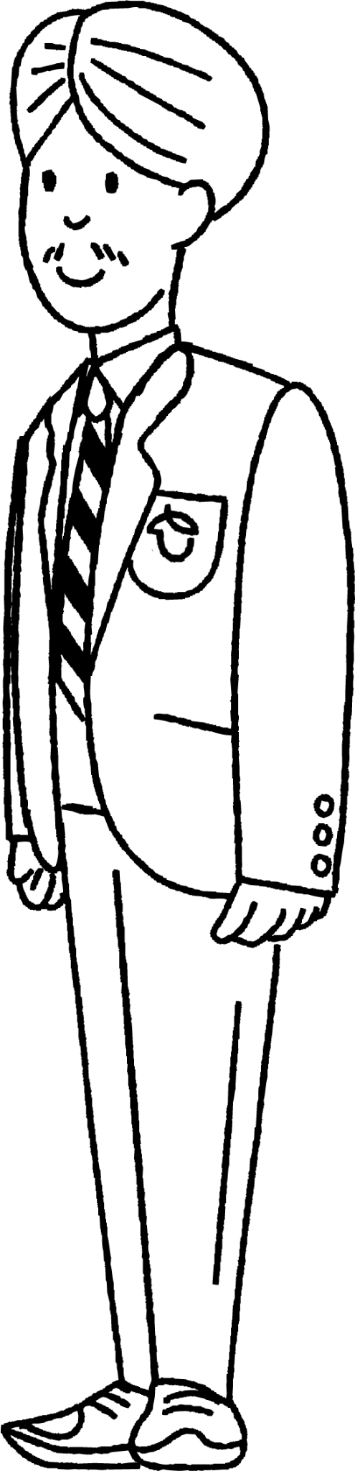

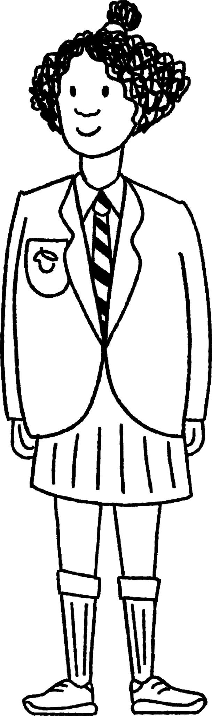
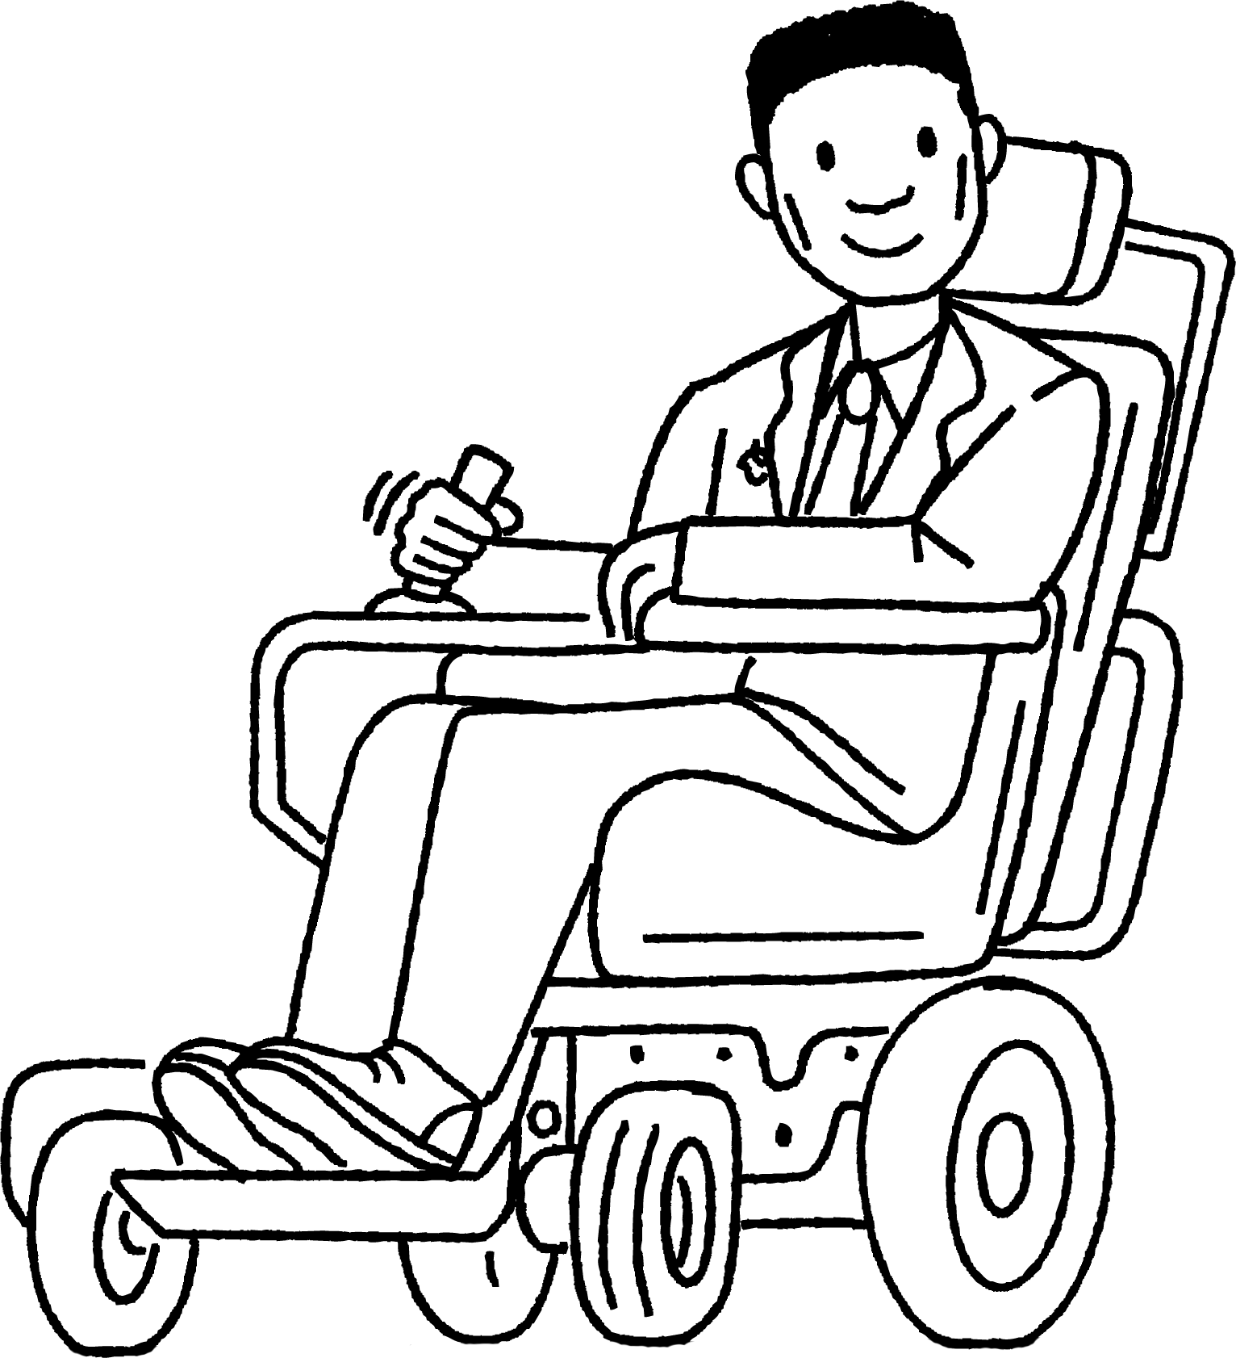
Checking understanding of ordering and comparing numbers
Task B: Comparing numbers using ≤ and ≥
Laura invites her friends out for her birthday. At the theme park you get half price entry if you are under 1.5 m tall.
1) Complete the mathematical statement to describe the situation:
2) Who will get half price entry?
height
<
1.5 m
Sofia and Izzy will get half price entry.
Laura wants to ride a big roller coaster. It says you have to be at least 1.45 m tall to ride it.
3) Write a mathematical statement to describe this.
4) Who can ride on the roller coaster?
height
≥
1.45 m
Laura, Lucas, Andeep, Alex and Izzy can ride the big roller coaster.
After visiting the theme park Laura is going to the cinema to watch a film that has a rating of 12.
5) Write a mathematical statement to describe this.
age ≥ 12
6) Is Laura’s choice of film a good one if she wants her friends to come along? Can you justify your answer?
Laura is the only person who is old enough to watch the film so perhaps she should choose a different film if she wants to watch with her friends.
Sofia 1.44 m Age 11.75
Laura 1.54 m
Age 12
Andeep1.49 m
Age 11
Alex
1.53 m
Age 11.5
Lucas
1.5 m
Age 11.25
Izzy
1.45 m Age 11.5
Mathematics in Education and Industry
v2.2

